Slide 1
4:1o-19

Slide 2
4:1o-19
‘bad’
“Why do ‘bad’ things happen to ‘good’ people?”
????
‘good’

Slide 3
4:1o-19

Slide 4
4:1o-19
1 Peter 4:11-19 ~ ¹¹ If anyone speaks, let him speak as the oracles of God. If anyone ministers, let him do it as with the ability which God supplies, that in all things God may be glorified through Jesus Christ, to whom belong the glory and the dominion forever and ever. Amen.
¹² Beloved, do not think it strange concerning the fiery trial which is to try you, as though some strange thing happened to you; ¹³ but rejoice to the extent that you partake of Christ’s sufferings, that when His glory is revealed, you may also be glad with
exceeding joy.

Slide 5
4:1o-19
1 Peter 4:11-19 ~ ¹⁴ If you are reproached for the name of Christ, blessed are you, for the Spirit of glory and of God rests upon you. On their part He is blasphemed, but on your part He is glorified. ¹⁵ But let none of you suffer as a murderer, a thief, an evildoer, or as a busybody in other people’s matters. ¹⁶ Yet if anyone suffers as a Christian, let him not be ashamed, but let him glorify God in this matter.
¹⁷ For the time has come for judgment to begin at the house of God; and if it begins with us first, what will be the end of those who do not obey the gospel
of God?

Slide 6
4:1o-19
1 Peter 4:11-19 ~ ¹⁸ Now
“If the righteous one is scarcely saved,
Where will the ungodly and the sinner appear?”
¹⁹ Therefore let those who suffer according to the will of God commit their souls to Him in doing good, as to a faithful Creator.

Slide 7
4:1o-19

Slide 8
4:1o-19
gift ~ charisma – a thing of grace
manifold ~ poikilos – variegated, multifaceted

Slide 9
4:1o-19

Slide 10
4:1o-19
oracles ~ logion ~ diminutive of logos
little words

Slide 11
4:1o-19

Slide 12
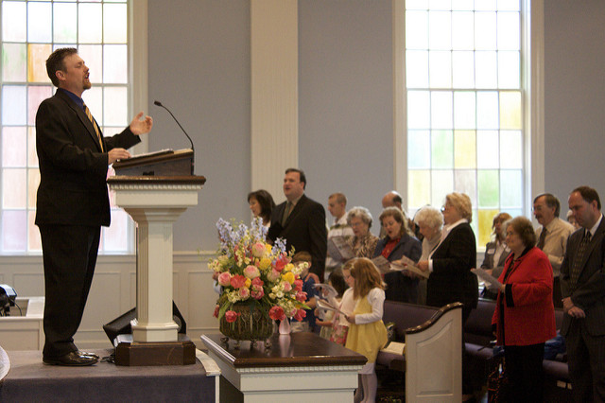
4:1o-19
The pastor
The ministers

Slide 13
4:1o-19
Nothing is sadder than seeing God’s gifts building up self
Nothing is more beautiful than seeing God’s gifts gifts building up the body

Slide 14
4:1o-19
The sermon was sluggish,
‘Twas hard attention to keep.
The theme was faultily chosen,
It almost put me to sleep.
Monday was blue with sheer boredom;
Tuesday was carnal by choice.
Wednesday my conscience was wakened
By pleas from a still, small voice.
Prayer meeting left me uplifted,
Loyalty lingering long.
Thursday my heart was responding;
Friday’s nudging was strong.

Slide 15
4:1o-19
I came through to repentance
The following Saturday;
I yielded in full surrender
As all on the altar I lay.
Sunday sermon was perfect,
Superb and quite at its peak;
Amazing how greatly that pastor
Improved in just one week!
– Richard DeHaan

Slide 16
4:1o-19

Slide 17
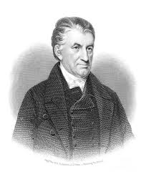
4:1o-19
Lyman Beecher, Boston
Church ~
“I preach on Sundays, the congregation preaches the rest of the week.”
Lyman Beecher (1775-1863)

Slide 18
4:1o-19

Slide 19
4:1o-19
I am not poor …
I am not sick …
I am not having
a trial …
Positive
confession
lying

Slide 20
4:1o-19

Slide 21
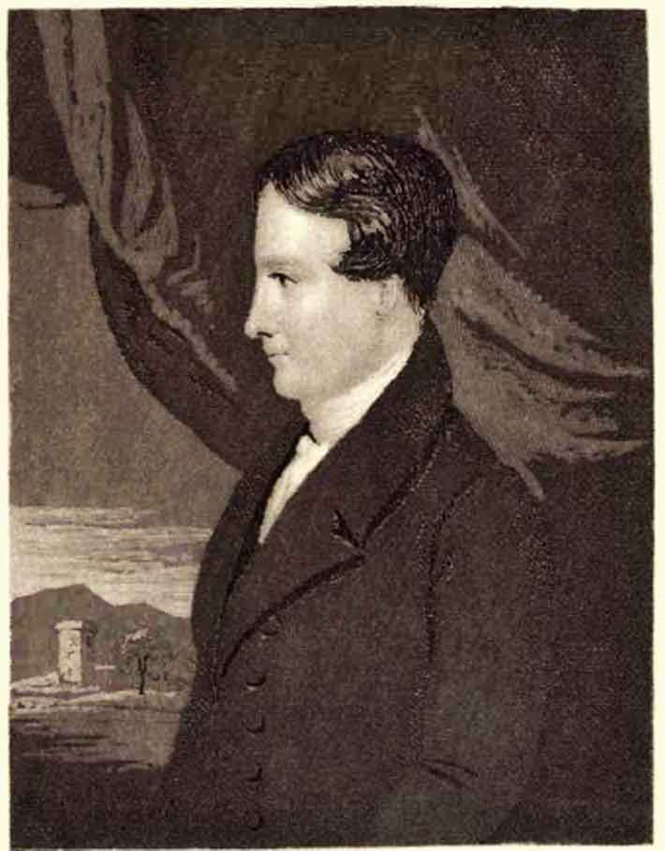
4:1o-19
Robert Murray M’Cheyne
(1813-1843) ~ “Every wise workman takes his tools away from the work from time to
time that they may be ground and sharpened; so does the only-wise Jehovah take his ministers oftentimes away into darkness and loneliness and trouble, that he may sharpen and prepare them for harder work in his service.”
Robert Murray M’Cheyne
(1813-1843)

Slide 22
4:1o-19

Slide 23
4:1o-19
fiery trial ~ pyrōsis – i.e. crucible
Coal
Diamond

Slide 24
4:1o-19

Slide 25
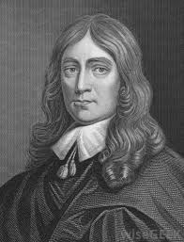
4:1o-19
John Milton ~ “It is not miserable
to be blind; it is miserable to
be incapable of enduring
blindness.”
John Milton (1608-1674)

Slide 26
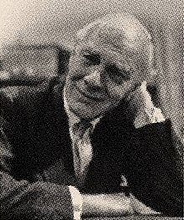
4:1o-19
Malcolm Muggeridge ~ “Supposing you eliminated suffering, what a dreadful place the world would be! I would almost rather eliminate happiness. The world would be the most ghastly place because everything that corrects the tendency of this unspeakable little creature, man, to feel over-important and over-pleased with himself would disappear.
Malcolm Muggeridge (1903-1990)

Slide 27
4:1o-19
Malcolm Muggeridge ~ He’s bad enough now, but he would be absolutely intolerable if he never suffered. However, we needn’t fear that.”
Malcolm Muggeridge (1903-1990)

Slide 28
4:1o-19

Slide 29
4:1o-19
partake ~ koinōneō – (verb form of koinōnia) to have all things in common with one another

Slide 30
4:1o-19

Slide 31
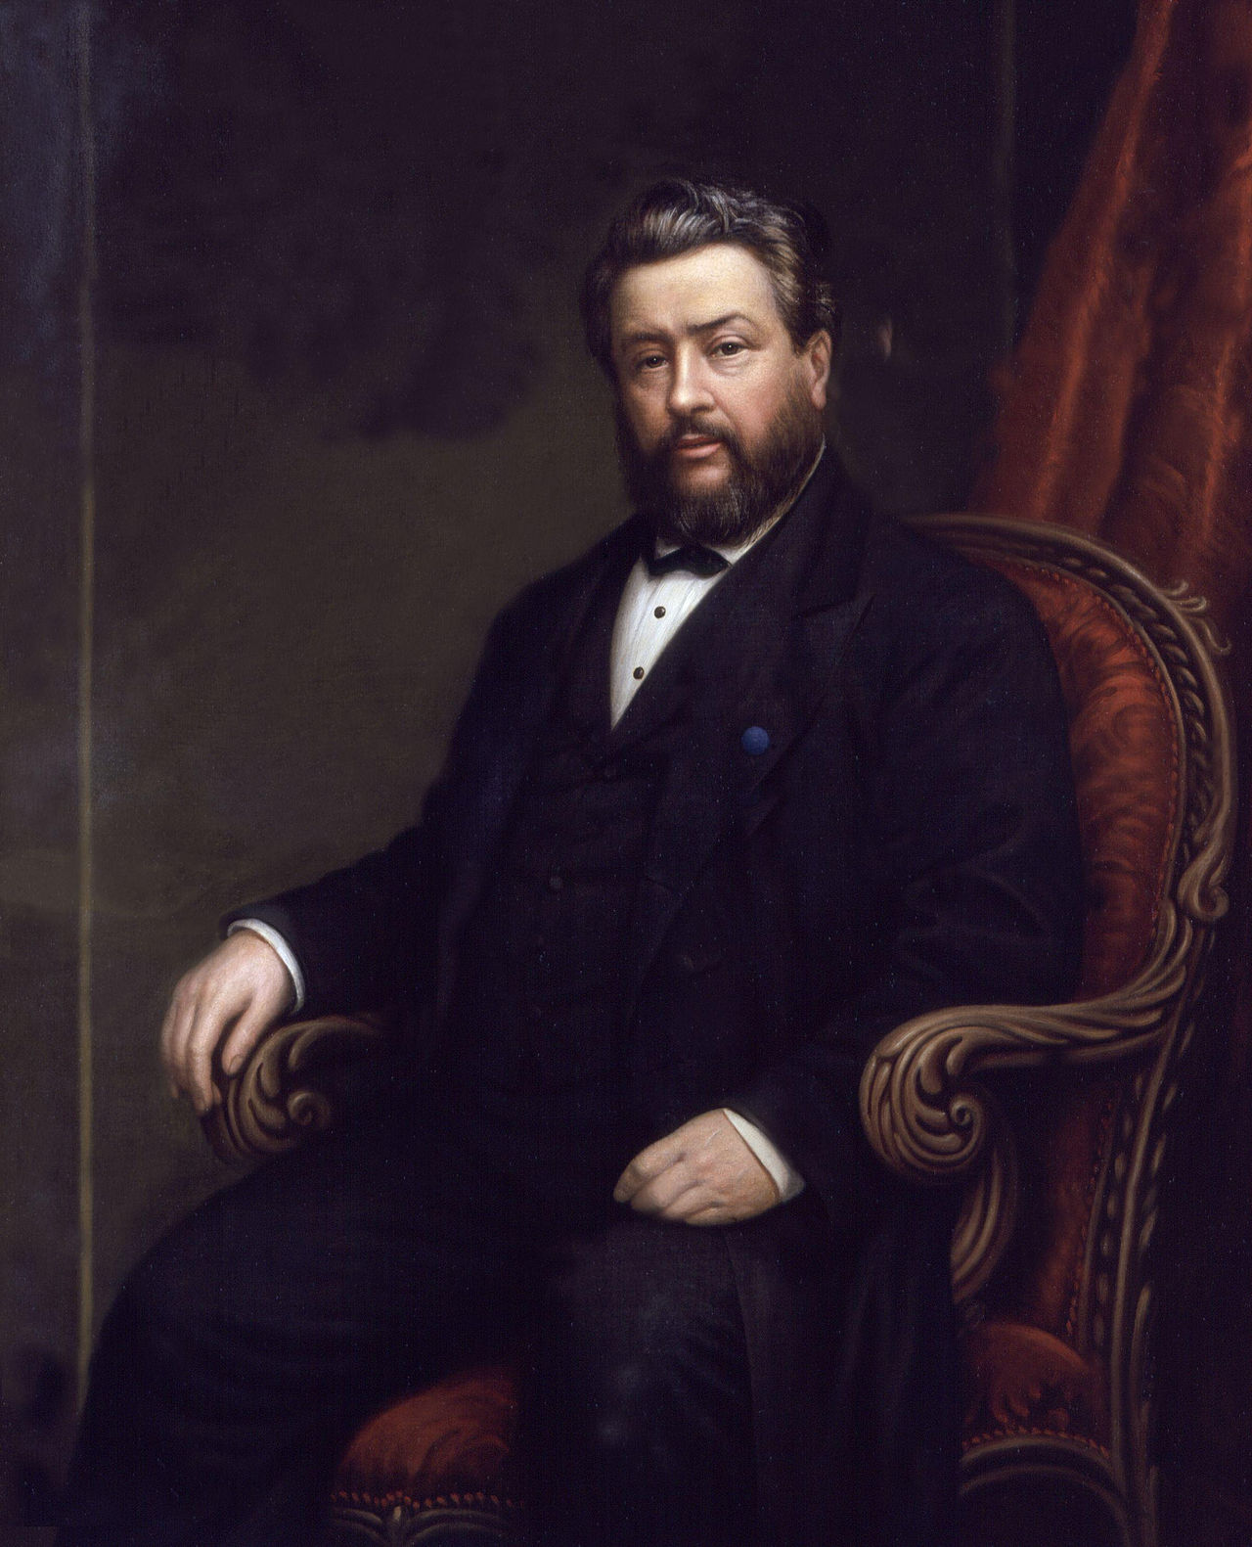
4:1o-19
C. H. Spurgeon ~ “I owe more to the fire and the hammer and the file than to anything else in my Lord’s workshop. I sometimes question whether I have ever learned anything except through the rod. When my schoolroom is darkened, I see most.”
C. H. Spurgeon
(1834-1982)

Slide 32
4:1o-19

Slide 33
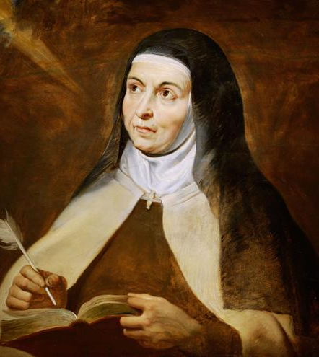
4:1o-19
Teresa of Avila (1515-1582) ~ “Flee a thousand leagues from saying
“I was in the right. It was not right for me to suffer this. They had no right to treat me so.” God deliver
us from all such rights. And when we receive honors, or affection,
or kind treatment, let us ask what right we have to them.”
Teresa of Avila
(1515 -1582)

Slide 34
4:1o-19

Slide 35
4:1o-19
busybody in other people’s matters ~ allotriepiskopos
allotrios, stranger; episkopos , overseer (bishop)

Slide 36
4:1o-19

Slide 37
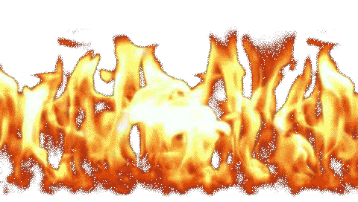
4:1o-19
scarcely ~ NASB better, with difficulty
Merrihew Standard Version ~ If it took the death of God’s only beloved Son to be able to save those who would receive His gift of salvation, what possible hope is there for those who don’t?
suffering later
suffering now … glory later
glory now
…

Slide 38
4:1o-19

